Slide 1
Information Gathering: Interactive Methods
4
Systems Analysis and Design
Kendall & Kendall
© 2008 Pearson Prentice Hall

Slide 2
Open-Ended Questions
Open-ended interview questions allow interviewees to respond how they wish, and to what length they wish
Open-ended interview questions are appropriate when the analyst is interested in breadth and depth of reply
Kendall & Kendall
4-<number>
Notes:
“Open” actually describes the interviewee’s options for responding. They are open.

Slide 3
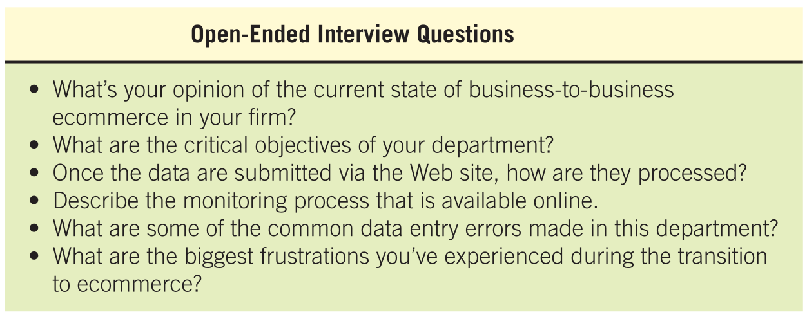
Kendall & Kendall
4-<number>

Slide 4
Advantages of Open-Ended Questions
Puts the interviewee at ease
Allows the interviewer to pick up on the interviewee's vocabulary
Provides richness of detail
Reveals avenues of further questioning that may have gone untapped
Kendall & Kendall
4-<number>

Slide 5
Advantages of Open-Ended Questions (Continued)
Provides more interest for the interviewee
Allows more spontaneity
Makes phrasing easier for the interviewer
Useful if the interviewer is unprepared
Kendall & Kendall
4-<number>

Slide 6
Disadvantages of Open-Ended Questions
May result in too much irrelevant detail
Possibly losing control of the interview
May take too much time for the amount of useful information gained
Potentially seeming that the interviewer is unprepared
Possibly giving the impression that the interviewer is on a "fishing expedition”
Kendall & Kendall
4-<number>
Notes:
The analyst needs to carefully consider the implications of using open-ended questions for interviewing.

Slide 7
Closed Interview Questions
Closed interview questions limit the number of possible responses
Closed interview questions are appropriate for generating precise, reliable data that is easy to analyze
The methodology is efficient, and it requires little skill for interviewers to administer
Kendall & Kendall
4-<number>
Notes:
The alternative to open-ended questions.

Slide 8
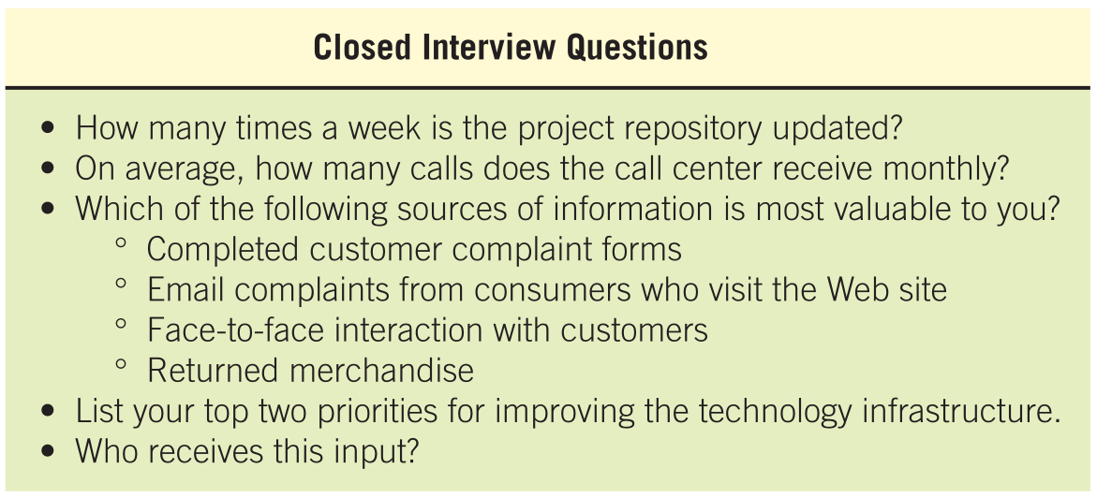
Kendall & Kendall
4-<number>

Slide 9
Benefits of Closed Interview Questions
Saving interview time
Easily comparing interviews
Getting to the point
Keeping control of the interview
Covering a large area quickly
Getting to relevant data
Kendall & Kendall
4-<number>

Slide 10
Disadvantages of Closed Interview Questions
Boring for the interviewee
Failure to obtain rich detailing
Missing main ideas
Kendall & Kendall
4-<number>
Notes:
As the interviewer you must think carefully about the question types you will use.

Slide 11
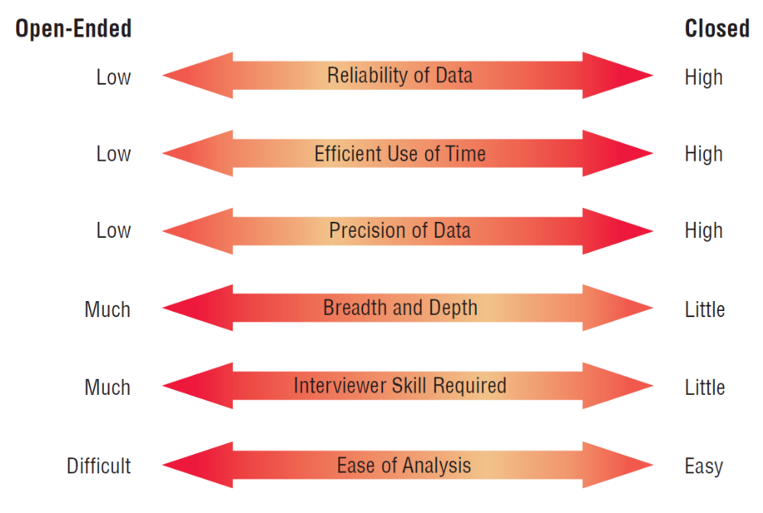
Figure 4.5 Attributes of 0pen-ended and closed questions
Kendall & Kendall
4-<number>
Notes:
Choosing one question type over the other involves a trade-off; although an open-ended question affords breath and depth of reply, responses to open-ended questions are difficult to analyze.

Slide 12
Bipolar Questions
Bipolar questions are those that may be answered with a ‘yes’ or ‘no’ or ‘agree’ or ‘disagree’
Bipolar questions should be used sparingly
A special kind of closed question
Kendall & Kendall
4-<number>
Notes:
This type of closed question limits the interviewee even further by allowing a choice on either “pole”, such as yes or no, true or false, agree or disagree.

Slide 13
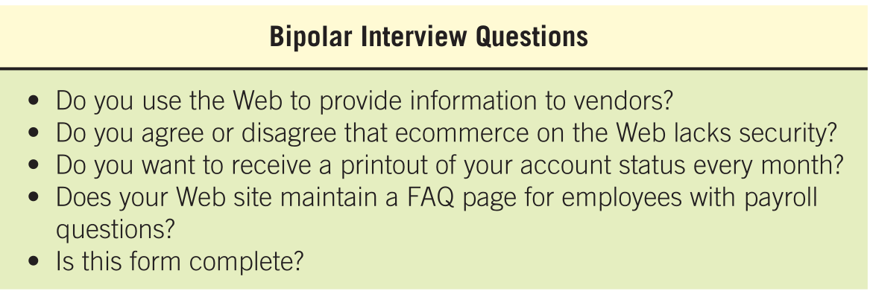
Kendall & Kendall
4-<number>

Slide 14
Probes
Probing questions elicit more detail about previous questions
The purpose of probing questions is:
  To get more meaning
  To clarify
  To draw out and expand on the interviewee's point
May be either open-ended or closed
Kendall & Kendall
4-<number>
Notes:
Used as a follow-up question.
The strongest probe is simply - Why?
It is essential to probe so that we don’t accept superficial answers.

Slide 15
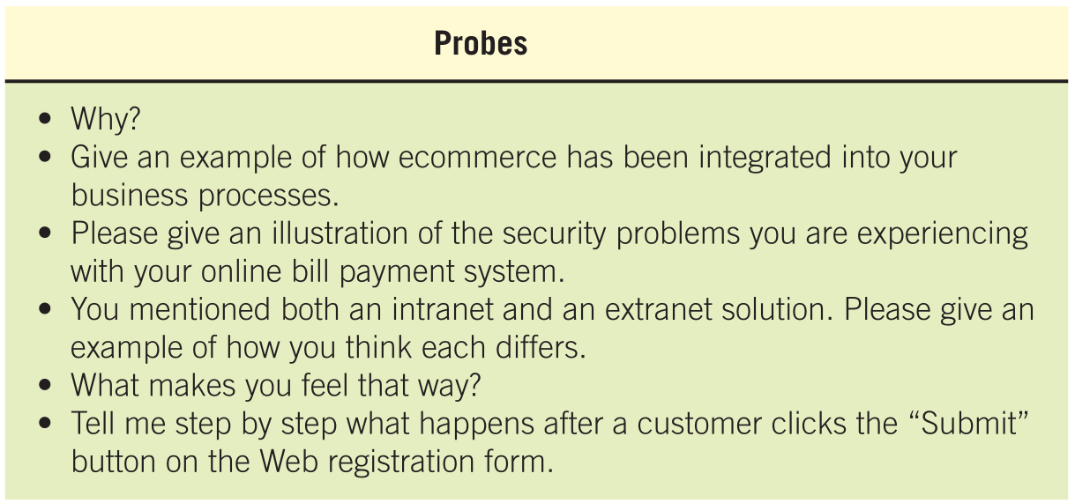
Kendall & Kendall
4-<number>

Slide 16
Arranging Questions
Pyramid
  starting with closed questions and working toward open-ended questions
Funnel
  starting with open-ended questions and working toward closed questions
Diamond
  starting with closed, moving toward open-ended, and ending with closed questions
Kendall & Kendall
4-<number>
Notes:
There are two ways of organizing interviews – Pyramid and Funnel, the diamond approach combines both.

Slide 17
Pyramid Structure
Begins with very detailed, often closed questions
Expands by allowing open-ended questions and more generalized responses
Is useful if interviewees need to be warmed up.
Kendall & Kendall
4-<number>
Notes:
Inductive organization of interview questions.
Also useful if you want an ending determination about the topic.

Slide 18
Funnel Structure
Begins with generalized, open-ended questions
Concludes by narrowing the possible responses using closed questions
Provides an easy, non-threatening way to begin an interview
Kendall & Kendall
4-<number>
Notes:
Deductive organization of interview questions.

Slide 19
Diamond Structure
A diamond-shaped structure begins in a very specific way
Then more general issues are examined
Concludes with specific questions
Combines the strength of both the pyramid and funnel structures
Takes longer than the other structures
Kendall & Kendall
4-<number>
Notes:
The diamond structure combines the strengths of the pyramid and funnel approach but has the disadvantage of taking longer.

Slide 20
Closing the Interview
Always ask “Is there anything else that you would like to add?”
Summarize and provide feedback on your impressions
Ask whom you should talk with next
Set up any future appointments
Thank them for their time and shake hands
Kendall & Kendall
4-<number>
Notes:
“Is there anything else that you would like to add?” – considered a formula question the response will often be “No.”
In form the interviewee about the next steps to take.
Always remember to thank the interviewee for their time.

Slide 21
Interview Report
Write as soon as possible after the interview
Provide an initial summary, then more detail
Review the report with the respondent
Kendall & Kendall
4-<number>
Notes:
The longer you wait to write your report, the more suspect your data becomes.
Review the report with the respondent – this helps clarify the meaning the interviewee had in mind and lets the interviewee know that you care.

Slide 22
Joint Application Design (JAD)
Joint Application Design (JAD) can replace a series of interviews with the user community
JAD is a technique that allows the analyst to accomplish requirements analysis and design the user interface with the users in a group setting
Developed by IBM.
Kendall & Kendall
4-<number>
Notes:
An alternative approach to interviewing users one by one.
The motivation was to cut the time and hence the cost required by interviews. It also create more use identification with new systems as a result of the participative process.

Slide 23
Conditions that Support the Use of JAD
Users are restless and want something new
The organizational culture supports joint problem-solving behaviors
Analysts forecast an increase in the number of ideas using JAD
Personnel may be absent from their jobs for the length of time required
Kendall & Kendall
4-<number>

Slide 24
Who Is Involved
Executive sponsor
IS Analyst
Users
Session leader
Observers
Scribe
Kendall & Kendall
4-<number>
Notes:
All project team members must be committed to the JAD approach and become involved.
Executive sponsor – a senior person who will introduce and conclude the JAD session.
IS Analyst – gives an expert opinion about any disproportionate costs of solutions proposed
Users – try to select users that can articulate what information they need to perform their jobs as well as what they desire in anew or improved computer system.
Session leader – someone who has excellent communication skills to facilitate appropriate interactions.
Observers – analysts or technical experts from other functional areas to offer technical explanations and advice.
Scribe – formally write down everything that is done.

Slide 25
Benefits of JAD
Time is saved, compared with traditional interviewing
Rapid development of systems
Improved user ownership of the system
Creative idea production is improved
Kendall & Kendall
4-<number>
Notes:
Some organizations have estimated a 15-percent time savings over traditional.
Helps users become involved early in systems projects and treats their feedback seriously.
Much like brainstorming which allows for creative idea production.

Slide 26
Drawbacks of Using JAD
JAD requires a large block of time to be available for all session participants
If preparation or the follow-up report is incomplete, the session may not be successful
The organizational skills and culture may not be conducive to a JAD session
Kendall & Kendall
4-<number>
Notes:
It is not possible to do other activities concurrently or to time-shift any activities, as is typically done in one-to-one interviewing.
It is a judgmental decision if the organization is truly committed to, and prepared for , this approach.

Slide 27
Questionnaires
Questionnaires are useful in gathering information from key organization members about:
  Attitudes
  Beliefs
  Behaviors
  Characteristics
Kendall & Kendall
4-<number>
Notes:
Attitudes – what people in the organization say they want.
Beliefs – what people think is actually true.
Behavior – what organizational members do.
Characteristics – properties of people or things.

Slide 28
Planning for the Use of Questionnaires
Organization members are widely dispersed
Many members are involved with the project
Exploratory work is needed
Problem solving prior to interviews is necessary
Kendall & Kendall
4-<number>

Slide 29
Question Types
Questions are designed as either:
  Open-ended
    Try to anticipate the response you will get
    Well suited for getting opinions
  Closed
    Use when all the options may be listed
    When the options are mutually exclusive
Kendall & Kendall
4-<number>
Notes:
Even when you write an open-ended question, it must be narrow enough to guide respondents to answer in a specific way.
Use open-ended questions when it is impossible to list effectively all possible responses to a question.

Slide 30
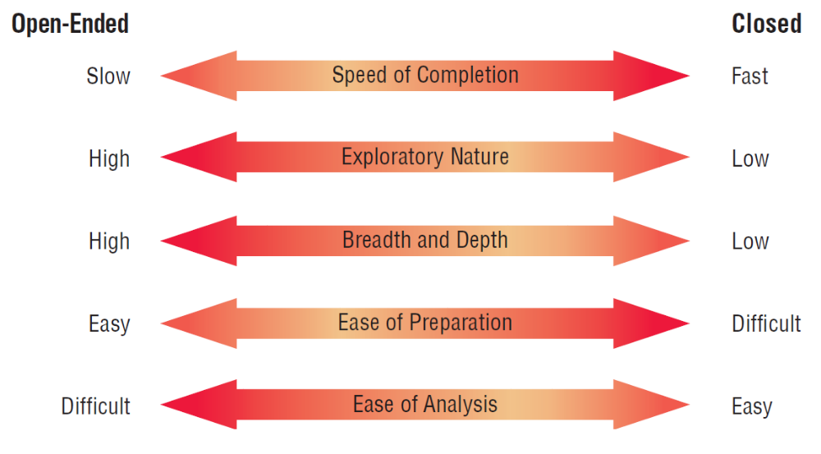
Figure 4.12 Trade-offs between the use of open-ended and closed questions on questionnaires
Kendall & Kendall
4-<number>

Slide 31
Questionnaire Language
Simple
Specific
Short
Not patronizing
Free of bias
Addressed to those who are knowledgeable
Technically accurate
Appropriate for the reading level of the respondent
Kendall & Kendall
4-<number>
Notes:
Write questionnaires in the respondents own language usage.
Simple – Use the language of the respondents whenever possible.
Specific – work at being specific rather then vague in wording.
Short – keep questions short
Not patronizing – do not talk down to participants through low-level language choices.
Free of bias – also means avoiding objectionable questions.
Addressed to those who are knowledgeable – target questions to correct respondents.

Slide 32
Measurement Scales
Scaling is the process of assigning numbers or other symbols to an attribute or characteristic for the purpose of measuring that attribute or characteristic.
The two different forms of measurement scales are:
  Nominal
  Interval
Kendall & Kendall
4-<number>

Slide 33
Nominal Scales
Nominal scales are used to classify things
It is the weakest form of measurement
Data may be totaled
What type of software do you use the most?
1 = Word Processor
2 = Spreadsheet
3 = Database
4 = An Email Program
Kendall & Kendall
4-<number>

Slide 34
Interval Scales
An interval scale is used when the intervals are equal
There is no absolute zero
Examples of interval scales include the Fahrenheit or Centigrade scale
How useful is the support given by the Technical Support Group?
NOT USEFUL EXTREMELY
AT ALL USEFUL
1 2 3 4 5
Kendall & Kendall
4-<number>
Notes:
More complete analysis can be performed on interval scales.

Slide 35
Validity And Reliability
Reliability of scales refers to consistency in response—getting the same results if the same questionnaire was administered again under the same conditions
Validity is the degree to which the question measures what the analyst intends to measure
Kendall & Kendall
4-<number>
Notes:
Questionnaires must be valid and reliable.

Slide 36
Problems with scales
Leniency
Caused by easy raters
  Solution is to move the “average” category to the left or right of center
  Central Tendency
Central tendency occurs when respondents rate everything as average
  Improve by making the differences smaller at the two ends
  Adjust the strength of the descriptors
  Create a scale with more points
  Halo Effect
When the impression formed in one question carries into the next question
Solution is to place one trait and several items on each page
Kendall & Kendall
4-<number>

Slide 37
Methods of Administering the Questionnaire
Convening all concerned respondents together at one time
Personally administering the questionnaire
Allowing respondents to self-administer the questionnaire
Mailing questionnaires
Administering over the Web or via email
Kendall & Kendall
4-<number>
Notes:
The choice of administering the questionnaire may be determined by the existing business situation.
Both email and Web surveys are Self–administered; response are a little lower then other methods, but may result in less guarded answers.

Slide 38
Electronically Submitting Questionnaires
Reduced costs
Collecting and storing the results electronically
Kendall & Kendall
4-<number>
Notes:
Reminders can be sent.

